Slide 1







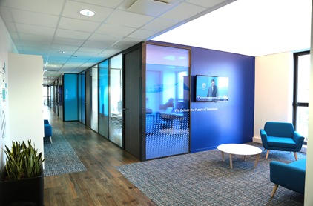
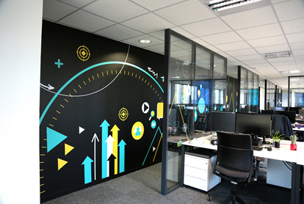


Broadpeak in a nutshell
Mission statement
Content & Network Service Providers rely on Broadpeak software video delivery solutions to scale their video audience on any device with the highest possible
Quality of Experience
100+ CUSTOMERS WORLDWIDE
220M END-USERS SERVED WORLDWIDE
20+ TBPS
INSTALLED STREAMING CAPACITY
6000+ PB OF VIDEO STREAMED EVERY MONTH

Slide 2
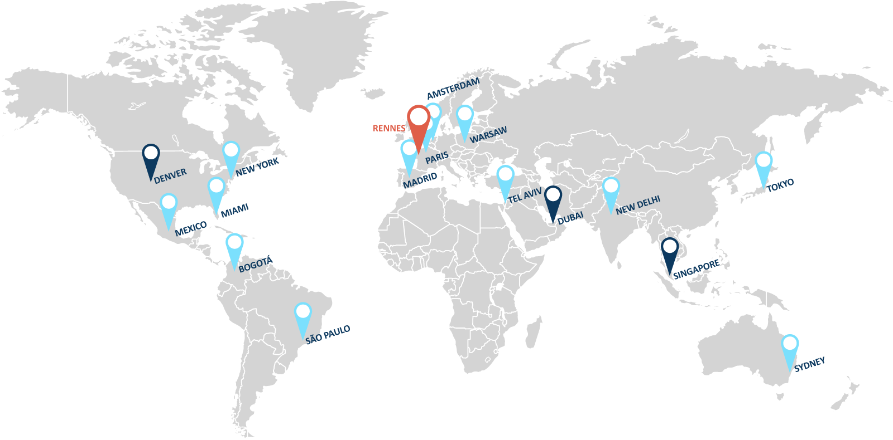



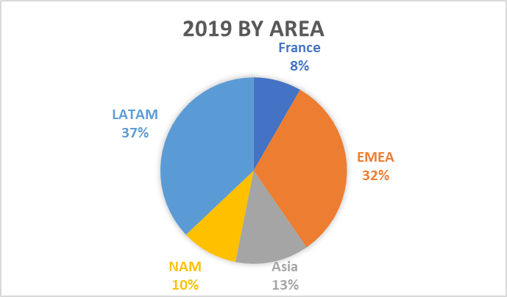
A global presence
Headquarter
Local representatives
Regional support offices

